Slide 1
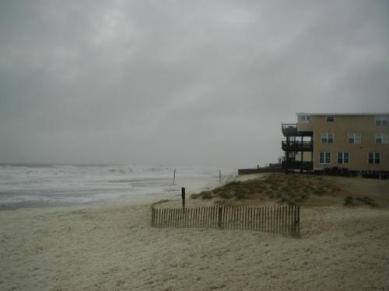
Virginia Beach and Sea Level Rise: Where Do We Go From Here?
Clay Bernick
City of Virginia Beach
Environment & Sustainability Office
October 26, 2011

Slide 2
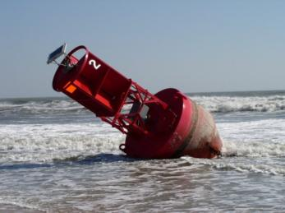
Five Items to Cover
What is the City’s adopted policy at present concerning Sea Level rise?
What kinds of issues does Sea Level Rise pose to the City?
How can the City begin to address Sea Level Rise issues?
What is the Virginia Beach Sustainability Plan?
How will information on Sea Level Rise be integrated into the City’s Sustainability Plan?

Slide 3
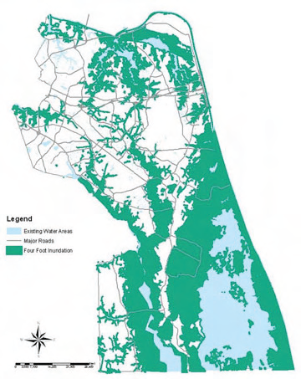
What is the City’s adopted policy at present concerning Sea Level Rise?
2009 Comprehensive Plan

Slide 4
2009 Comprehensive Plan Recommendations
Prohibit construction in floodplains without
acceptable mitigation.
Build on higher ground where it is less susceptible to sea level rise and make higher ground the prime focus of development.
Identify high ground shelters in case of emergency and provide ensured accessibility to those shelters
Aggressively retrofit existing storm drains throughout the City into state of the art stormwater management facilities to minimize flooding after heavy storms while also addressing water quality objectives.
Increase efforts to clean up contaminated sites suitable for reuse or redevelopment through appropriate incentives.
Strategically replace dunes and grasses in the most valuable and vulnerable shorelines.
Investigate techniques to mitigate incursion of
storm surge and tidal inundation of low-lying areas.
Evaluate and develop measures to increase reasonable structural setbacks in order to effectively protect properties facing the Chesapeake Bay and Atlantic Ocean.

Slide 5
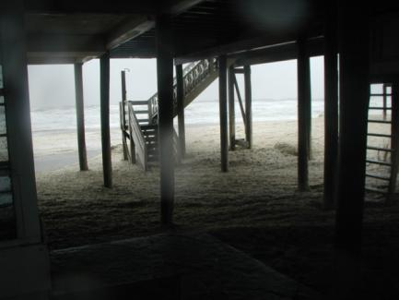
What kinds of issues does Sea Level Rise pose to the City?
Environmental
beaches, dunes, wetlands, waterways, natural habitat, water quality
Economic
employment centers, tourism, military, agriculture
Social
public health, public safety, evacuation, hazard management, social equity
Physical
public infrastructure (roads, stormwater, water, sewer, police, fire, schools, parks) and private infrastructure (electricity, gas, cable, UST’s, etc.)
Fiscal
property values, tax base, capital projects,
bond rating, borrowing capacity

Slide 6
How can the City begin to address Sea Level Rise issues?
Listening Sessions
Community perceptions, ideas, questions
Special Studies & Research
Targeted to address specific areas of concern (ex: beaches and dunes; floodplain protection, infrastructure vulnerability, etc.)
Development of Sustainability Plan
Develop new City policies and objectives which result in adjustments to existing strategies
Track Emerging research and Practices form Other Areas
Work with other communities in region and States to develop shared approaches
HRPDC, Northeast North Carolina, Eastern Shore, etc.

Slide 7
What is the Virginia Beach Sustainability Plan?
A document prepared with extensive community involvement that will define recommendations for City policy and actions to move the City forward in a broad array of areas (environmental, economic, physical, social and cultural) to enable the City to be a more sustainable community.

Slide 8
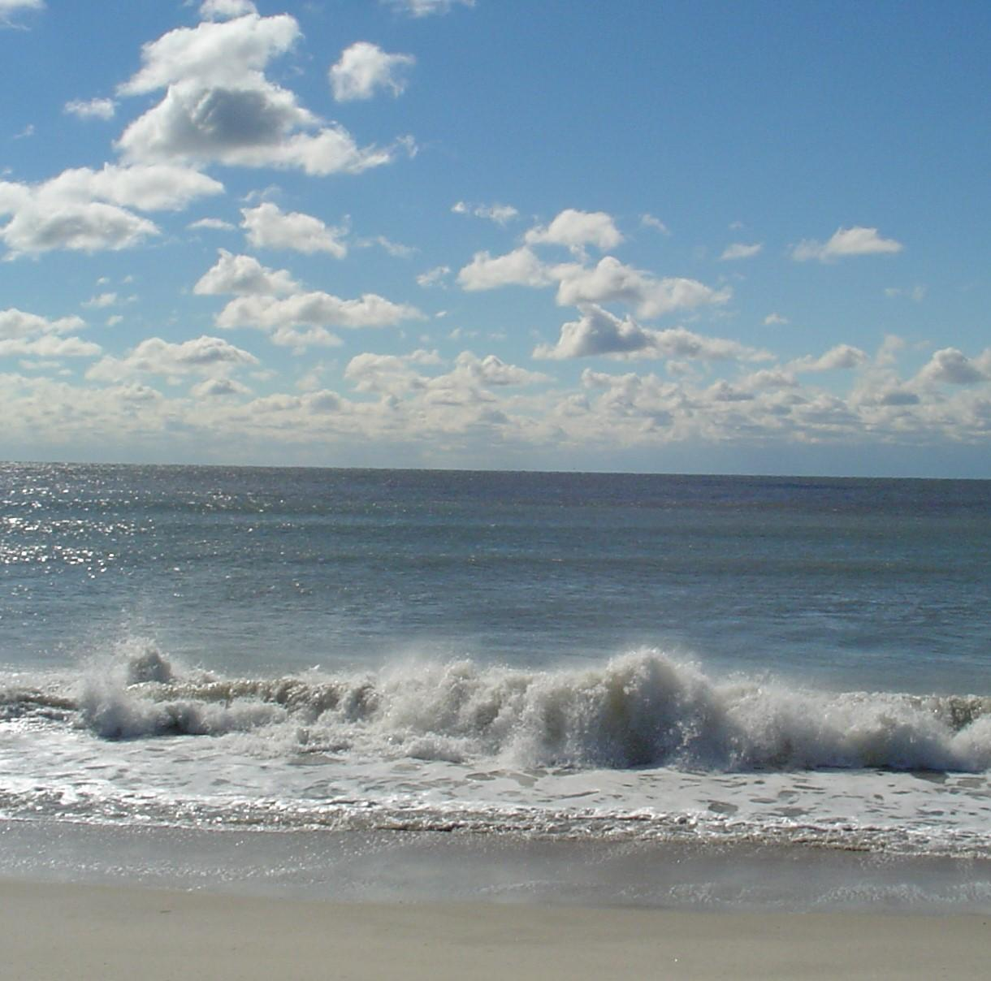
FISCAL
The Three Pillars
ENVIRONMENTAL
SOCIETAL

Slide 9
SIT’s
Envision 2040
Comp Plan
Sustainability Plan
Community
Input
SDAT
Green
Ribbon
Committee
Business
Input
Other Plans
& Policies
Plan Alignment

Slide 10
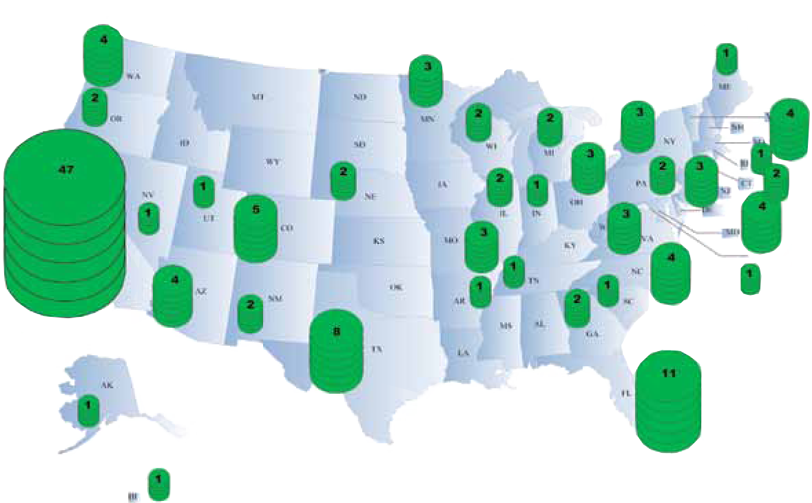
New York, NY
Chicago, IL
Los Angeles, CA
San Francisco, CA
Portland, OR
Seattle, WA
Denver, CO
Charlotte, NC
Arlington, VA
Charlottesville, VA
Chesapeake, VA
Sarasota, FL

Slide 11
How will the plan be Developed?
Alignment with City Mission, Council Vision and Strategic Plan, Sustainable City Model, other adopted policies and plans (Comprehensive Plan, Hazard Management Plan, Outdoors Plan, etc.)
Input from a series of facilitated community open houses
Input from AIA / SDAT Process

Slide 12
Sustainability Plan Schedule
Fall 2011: Complete Documentation of existing City plans, policies, actions and initiatives that relate to sustainability
Fall 2011: Initiate efforts to solicit input through Steering Committee, City staff Focus Groups, Community Input Sessions, Interviews
Late Spring 2012: Release initial draft plan for feedback
Summer 2012: Complete final draft plan for presentation to City Council for adoption

Slide 13
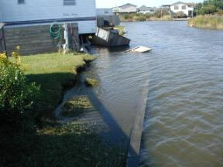
What can the City gain by addressing Sea Level Rise?
The same tools that can be used to mitigate sea level rise will also pay dividends in hurricane and coastal storm mitigation.
Better evacuation strategies
Lower insurance rates
Protection of property values and infrastructure
Better environmental quality
More adaptable and sustainable community

Slide 14
Core Partners Sponsors
SLR Listening Sessions March 2011
City of Virginia Beach
Wetlands Watch
Hampton Roads Planning District Commission
Old Dominion University
Virginia Aquarium and Marine Science Center
Virginia Coastal Zone Management Program
Virginia Environmental Endowment
West Wind Foundation

Slide 15
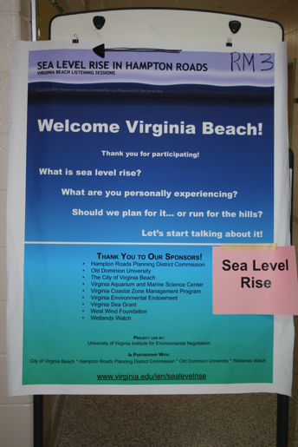
Goals for Listening Sessions
To elicit community experiences, concerns and suggestions regarding sea level rise.
To help residents gain an understanding and prepare for sea level rise in the Virginia Beach area.
Skip Stiles | Wetlands Watch

Slide 16
Outcomes
To synthesize community concerns
To GIS-map the diverse ways that the community experiences sea level rise (flooding, erosion, property value decline, etc.)
To inform the Virginia Beach Sustainability Plan
To test methods of gathering information (hand-held devices, written surveys, maps)
To start a regional conversation on sea level rise and engage partners in future opportunities

Slide 17
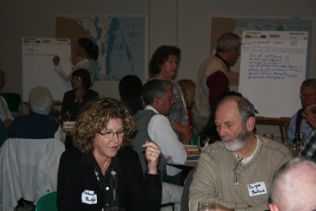
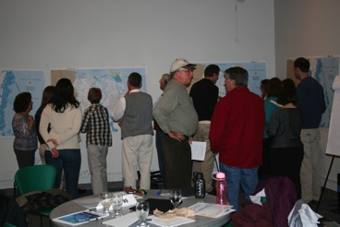
Listening Sessions
128 TOTAL Attendance
107 Survey Respondents
By Location
49 at Virginia Aquarium and Marine Science Center
22 at Red Mill Elementary School
25 at Meyera E. Oberndorf Central Library
32 at Bayside Recreation Center
Skip Stiles | Wetlands Watch

Slide 18
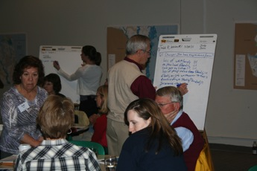
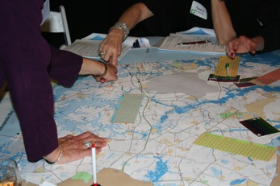
Observations
Attending listening sessions:
Retirees
Absent from listening sessions:
African Americans
Asian Americans
Hispanic or Latino Americans
Youth and students
Working class citizens
Skip Stiles | Wetlands Watch

Slide 19
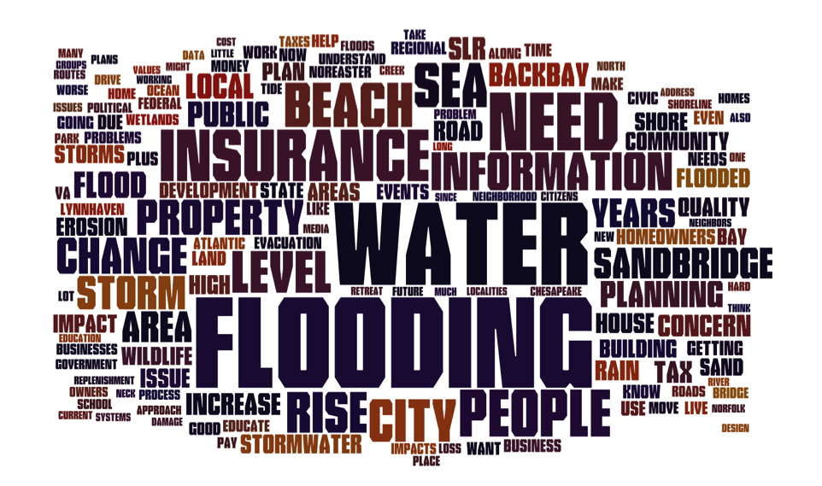
Big Themes

Slide 20
Community Thinks…
Sea level rise should be a priority issue for the City of Virginia Beach
Sea level rise should be included in decisions regarding:
Flood and hazard mitigation, infrastructure, and land-use planning
Land-use permitting
Fiscal budgets

Slide 21
Community Wants…
More local leadership and information on strategies to address sea level rise
To be involved in planning and land-use decisions
Local government to not allow redevelopment in flooded areas

Slide 22
Your Community is Experiencing…
Flooded Roadways
Traffic Re-routed
Storm Impacts
Flooding During Storms
Business Stress or Loss
Stormwater Overflows
Insurance Refused or Dropped
Environmental Changes
Erosion
Wildlife Habitat
Water Quality Issues

Slide 23
… Flooded Roadways

Slide 24
… Storm Impacts

Slide 25
… Environmental Changes

Slide 26
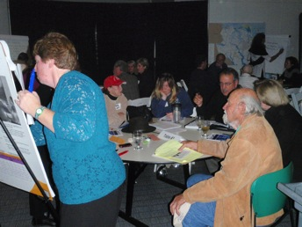
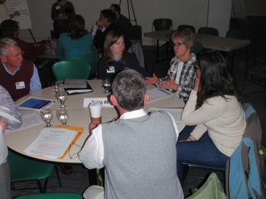
Community is Concerned About…
Their homes
Future generations
Regional economy
Property values
Local politics
Ecosystems/wildlife
Not concerned about:
Their jobs
Tanya Denckla Cobb | UVA-IEN

Slide 27
Actions Community Is Considering…

Slide 28
Resources Community Needs…

Slide 29
Responses Community Suggests…

Slide 30
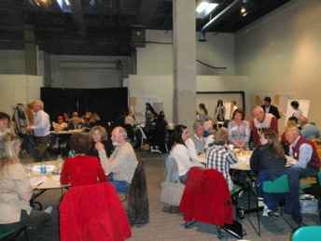
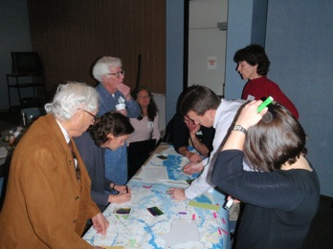
Community Thinks that
Sea Level Rise…
98% is a long-term problem
92% should be a priority for local governments
86% requires immediate action should be taken to deal with the effects
86% is a very important issue in the Virginia Beach area
Tanya Denckla Cobb | UVA-IEN

Slide 31
Possibilities for Next Steps
City could expand outreach and listening sessions to include absent demographic groups
Research team may conduct focus groups to ground-truth specific planning tools
Data sets, team approach with state and Federal Partners

Slide 32
Final Take-Aways…
More local leadership and information on strategies to address sea level rise
Citizens want to be involved in planning and land-use decisions
Local government to not allow redevelopment in flooded areas
Sea level rise should be a priority issue for the City of Virginia Beach
Sea level rise should be included in all levels of local decision-making

Slide 33
Questions?

